Slide 1
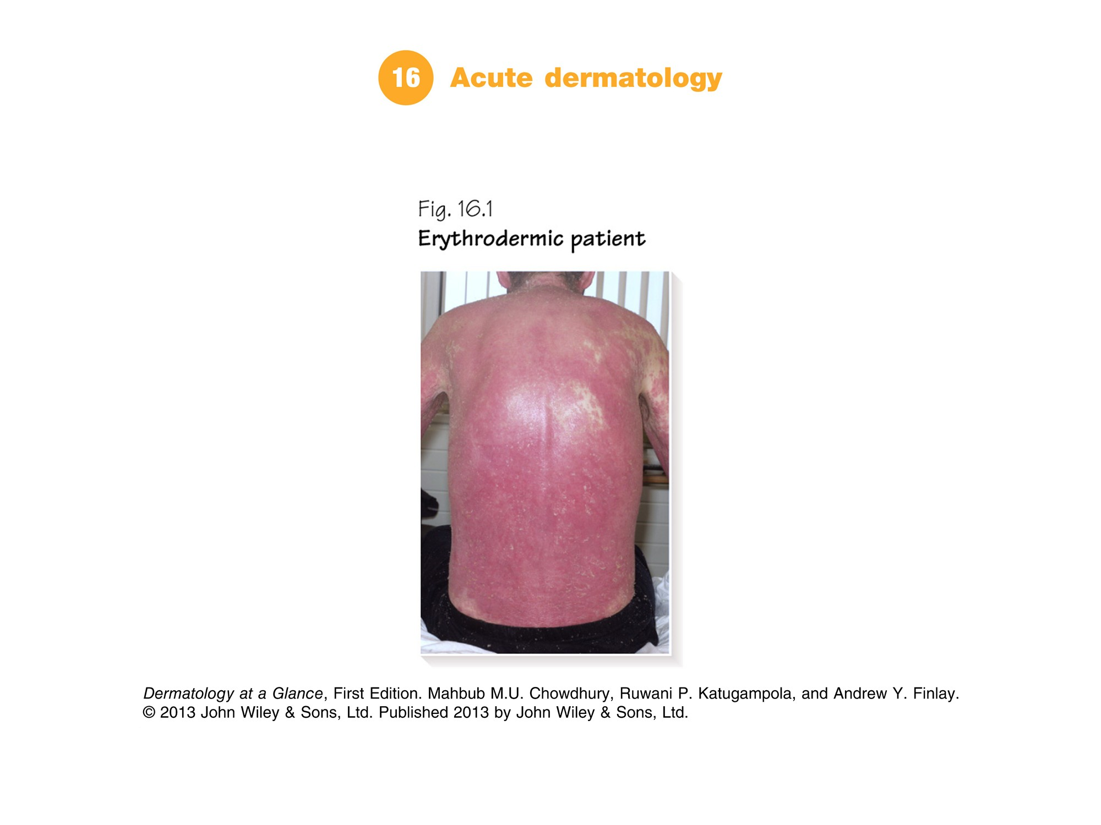
Notes:
Part 6 ER dermatology
Chapter 16 Acute dermatology | Chapter 17 Blistering skin diseases

Slide 2
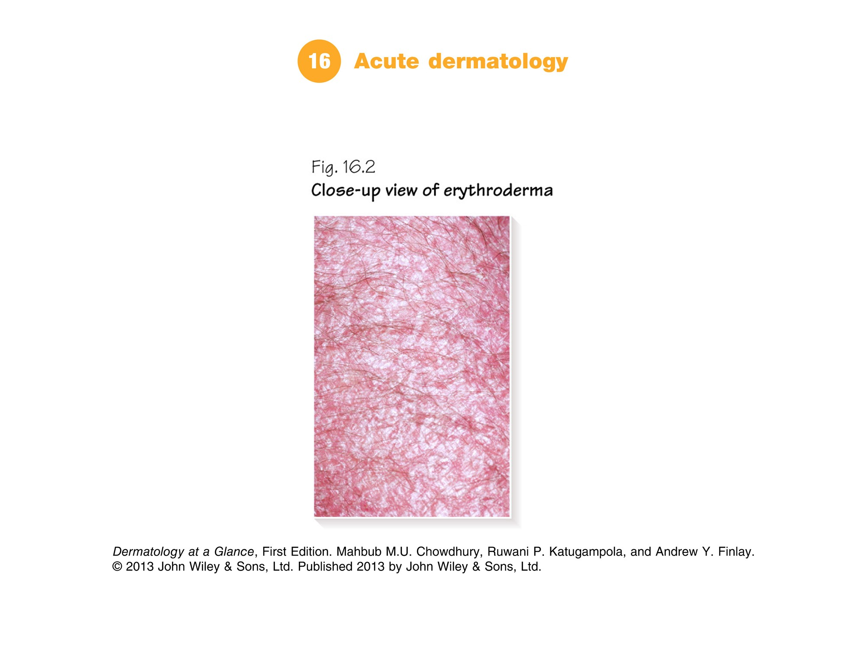

Slide 3
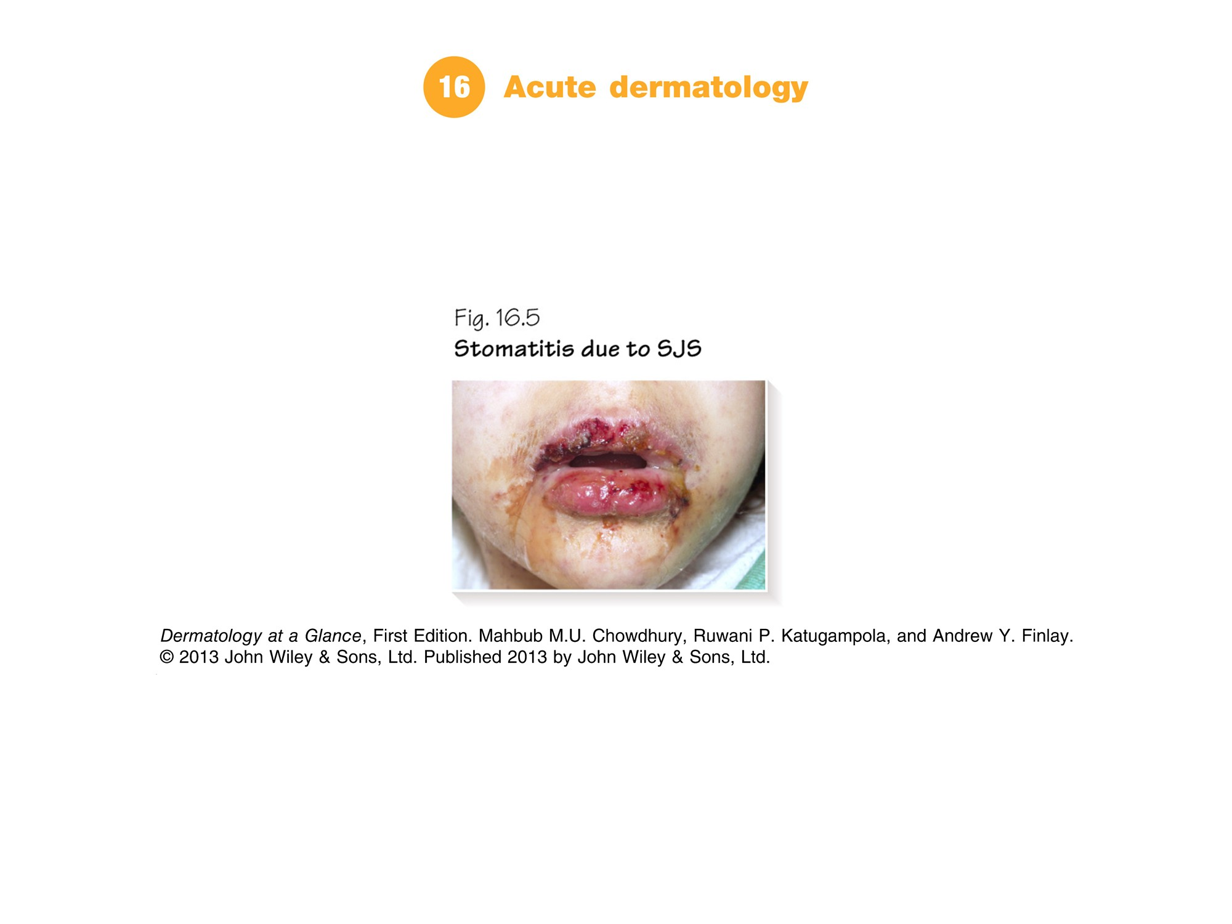

Slide 4
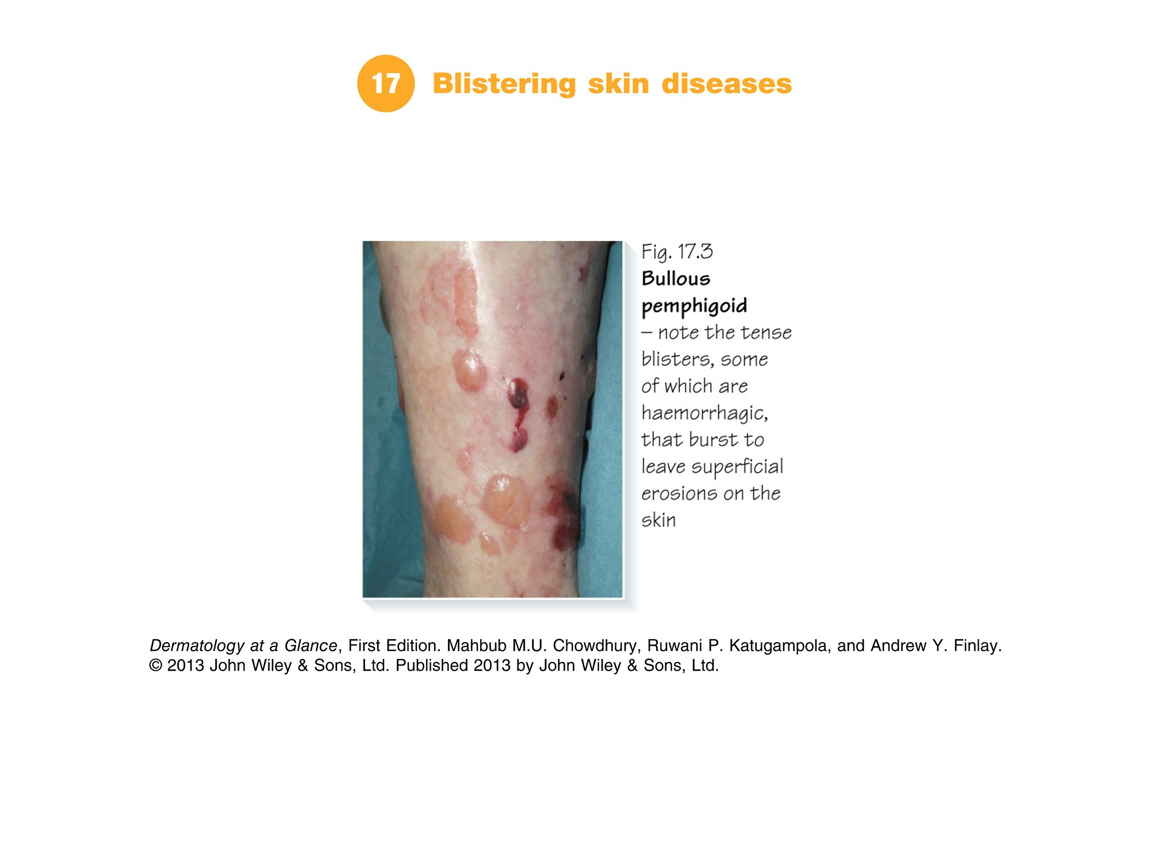

Slide 5
